Slide 1
Cyclone Preheater Anomaly Detection
Data Analysis using Machine Learning Algorithms
By Azeem Husain Khan

Slide 2
Data Preparation
Data Overview:
The dataset includes 370k records, collected every 5 minutes for 3 years.
Key Variables:
Cyclone_Inlet_Gas_Temp: Temperature of gas entering the cyclone.
Cyclone_Gas_Outlet_Temp: Temperature of gas leaving the cyclone.
Cyclone_Outlet_Gas_draft: Draft at the outlet of the cyclone.
Cyclone_cone_draft: Draft at the cone section.
Cyclone_Inlet_Draft: Draft at the inlet of the cyclone.
Cyclone_Material_Temp: Temperature of material at the outlet.
Data Treatment:
Conversion: Ensured that all columns were converted to numeric values.
Missing Values: Imputed missing data using the mean imputation method to maintain consistency in the dataset.
Timestamp Processing: Converted the time column into a datetime format for time series analysis.

Slide 3
Analysis Strategy
Methodology:
Exploratory Data Analysis (EDA): Identified trends, patterns, and relationships between variables using visualization tools like line plots.
Anomaly Detection Approach:
Algorithm Used: Applied Isolation Forest for anomaly detection, which is a robust unsupervised machine learning method.
Features Analyzed: Used all six variables (temperature and draft values) to detect abnormalities in the system.
Contamination: Set to 1%, meaning approximately 1% of the data points are flagged as anomalies.

Slide 4
Insights and Abnormal Periods
Findings:
The analysis identified 1% of the data as anomalies, corresponding to abnormal operations of the cyclone preheater.
Abnormalities were primarily identified during periods where the Cyclone Inlet Gas Temperature and Cyclone Outlet Gas Draft showed sharp fluctuations.
Key Takeaways:
These abnormal operations may indicate system malfunctions, such as improper gas flow, overheating, or equipment failure.
Detected anomalies provide opportunities for preventive maintenance and early interventions to avoid larger operational issues.

Slide 5
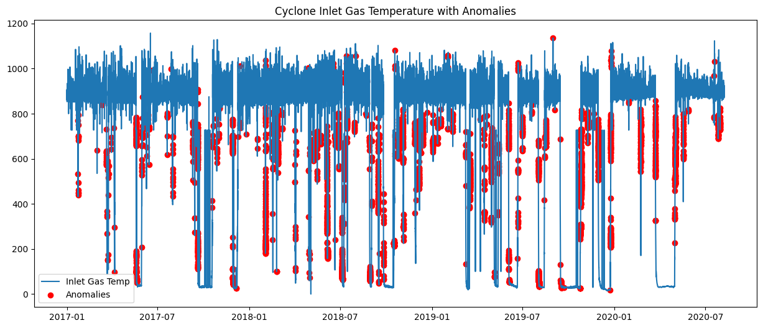
Conclusion
Summary:
Anomalies were successfully detected using the Isolation Forest algorithm, which helped identify abnormal periods in the cyclone preheater operation.
The insights gathered from this analysis can guide further investigations and process optimizations for industrial efficiency.
Next Steps:
Recommend further analysis of the detected abnormal periods.
Potential optimization of the system to prevent these abnormalities in the future.

